Slide 1
“Thank God it’s Monday!”
supporting Every Church
for Everyday Faith
7:00-7:30 Welcome and Coffee
7:30-8:45 Forum Discussion & Presentation
8:45-9:15 Deanery Synod Business

Slide 2
Can you think of a time when
your faith influenced you
outside of church,
Monday – Saturday?
*could be a prompting to pray,
speak or take action

Slide 3
Setting God’s People Free is an initiative to enable the whole people of God to live out the Good News of Jesus confidently in all of life,
Sunday to Saturday.
SGPF is a coordinated effort to change our culture as a church – locally and nationally – to more clearly resource the faith of ordinary Christians in everyday life.
Over the next few years, hundreds of worshipping communities, fresh expressions of church etc will be involved in helping discover what really does help us live our faith confidently in everyday life.

Slide 4
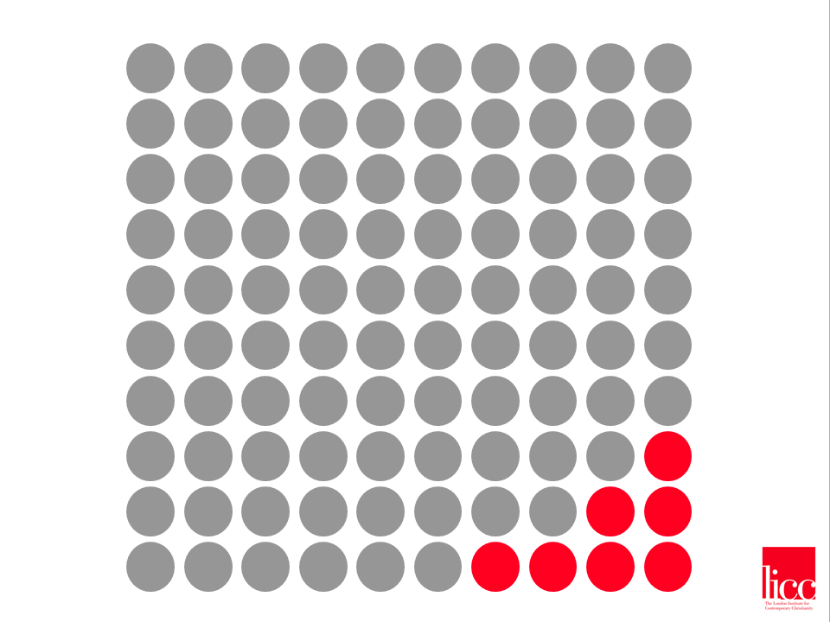
Notes:
The Problem:
We think of the church in the corner – either only engaged in mission together or somewhat defensive.
Whereas the truth is that the church is the church scattered as well as gathered. But most of the time we are scattered and we need to think of the missional potential of this view of church.
Therefore, we need a broader mission strategy than the traditional one.
The Problem was set out in the original Imagine DVD/Essay. This is still a good way to encourage churches to begin the journey. There is an Imagine DVD User Guide on the website. www.licc.org.uk and search or: http://tinyurl.com/78jdgk9
This includes an overview of the material, 4 small group sessions and a simple survey that could be used by a church group.
2 & 3. The Dots
The Church gathered:
in a corner and under pressure, or simply the place where all the action takes place, a limited connectedness with the wider world.
The Church scattered:
out in the world, scattered from one another, but touching so many more people.
Often when churches get together to talk about mission, it becomes a conversation about how we can reach people we do not know. We tell each other that we don’t have many non-Christian friends. That may be true but we are in contact with many people throughout the week. What would happen if we talked about how we could reach these people with the gospel?

Slide 5
Matthew 5
‘You are the light of the world.
A city built on a hill cannot be hidden.
No one after lighting a lamp puts it under
the bushel basket, but on the lampstand,
and it gives light to all in the house.
In the same way, let your light shine before others, so that they may see
your good works and give glory to your Father in heaven.

Slide 6
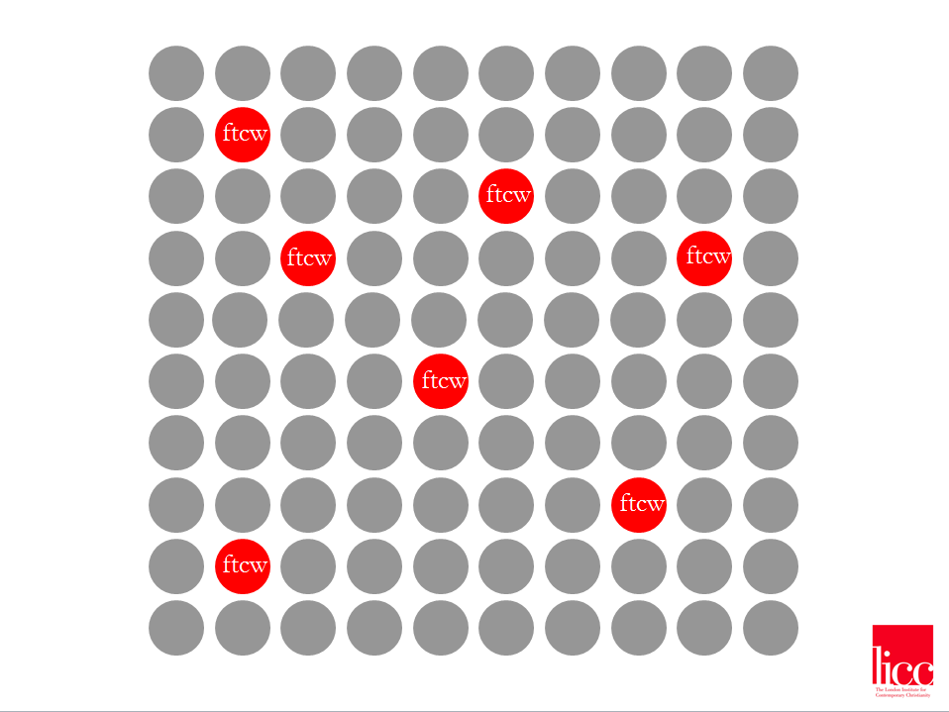

Slide 7
Notes:
The Central shift is to as how the 10 is connected to the 110.
168 hours in a week; you sleep for 48; 120 left.
Unless retired or a lot of discretionary time, the most time that most people can give to gathered church activities is 10 hours per week. That leaves 110. Where are they, what is happening and how are they living there as followers of Jesus. What can we be doing in the 10 hours to support people in their 110.
How is the 110 shaping the experience of the 10 hours.

Slide 8
Gathered + Scattered

Slide 9
FRONTLINE
Notes:
What do we mean by Frontline:
Places where you spend most of your time or the contexts that you feel you have most responsibility for.
Place where God is interested.
Places where God is at work in at least 2 ways:
To disciple you – how….
To use you as an agent of his kingdom – how….
Frontline is ultimately about the places where we are able to demonstrate te love of God and the purposes of God to a broken world, we are

Slide 10
M
a
k
e
a
d
i
f
f
e
r
e
n
c
e
w
h
e
r
e
y
o
u
a
r
e

Slide 11
Romans 12
Therefore, I urge you, brothers and sisters, in view of God’s mercy, to offer your bodies as a living sacrifice, holy and pleasing to God—this is your true and proper worship. Do not conform to the pattern of this world, but be transformed by the renewing of your mind. Then you will be able to test and approve what God’s will is—his good, pleasing and perfect will.

Slide 12
Who am I?
Where am I?
Why am I here?
What has God
done?

Slide 13
7 small shifts
1. BE CURIOUS
2. VISITING PEOPLE IN CONTEXT
3. SUNDAY PRAYING FOR MON TO SAT LIVING
4. THIS TIME TOMORROW
5. WHAT’S NOTICED ON NOTICE BOARDS?
6. COMMISSIONING PEOPLE
7. PREACHING MATTERS

